Slide 1
CAREER INFORMATION AND RECRUITMENT PORTAL
Project Guide: Ms. Sruthimol M P
Lecturer
Department of Information Technology
Group Members:
Jincy P Janardhanan (IEAREIT017)
Aleena Sunny (IEAREIT006)
Alka Bhagavaldas K (IEAREIT007)
Ameena Shirin (IEAREIT009)

Slide 2
CONTENTS
Problem Statement
Motivation
Objectives
System Study
Requirements Gathering and Analysis
SRS Document
Design
References

Slide 3
PROBLEM STATEMENT
Students can’t find the right job.
Recruiters can’t access student details.
Important functions may be missed.
Students miss recruiter updates.
No effective placement cell management.

Slide 4
MOTIVATION
Provide a user-friendly recruitment portal platform.
Ease the work of staffs.
Provide medium to choose best companies and employees.
Provide categorized and suitable jobs.
Increase knowledge about job resources.

Slide 5
OBJECTIVES
Developing a web application for career information and recruitment.
Connect students, colleges, recruiters and alumni.
Ease of job application.
Easily maintain job information and applications.
Easily review CV of student or alumni.
Recruiters can easily maintain job details.

Slide 6
SYSTEM STUDY
EXISTING SYSTEM
PROPOSED METHODOLOGY
Manually maintained
Time consuming
Difficult to updating data
Errors can occur
Data storing is difficult
A secure and easy-to-use web application in Java using Spring boot and Spring security frameworks
Placement cell management for colleges
Student or alumni hiring for recruiters
Job finding opportunity for student and alumni
FEASIBILITY STUDY
Feasible on a system with basic requirements
Technical feasibility: easy to use
Easy to maintain the operation
Schedule and maintenance is easier
Low budget

Slide 7
REQUIREMENTS GATHERING AND ANALYSIS
END-USER REQUIREMENTS
HARDWARE REQUIREMENTS
SOFTWARE REQUIREMENTS
PC with basic requirements
Stable network connection
4 GHz minimum, multi-core processor
RAM: Minimum 2 GB
Hard disk space: Minimum 10 GB
Operating System:
Windows 7+
Mac OS X Yosemite 10.10+
Linux: 64-bit Ubuntu 14.04+, Debian 8+, openSUSE 13.3+ or Fedora Linux 24+
Front end: Thymeleaf
Back end: Spring boot, Spring security and MongoDB
Web server: Embedded Tomcat
Supported browsers: Chrome, Firefox, Internet Explorer 9+
Java 1.8+

Slide 8
SRS DOCUMENT
Software Requirements Specification (SRS), documents all expected functionalities of a system/application by the end user.
Our SRS Document for this project can be found from here.

Slide 9
DESIGN
A high level design of our project including all modules, functions, priorities and iterations has been made into an excel spreadsheet and can be found from here.

Slide 10
DATA FLOW DIAGRAMS

Slide 11
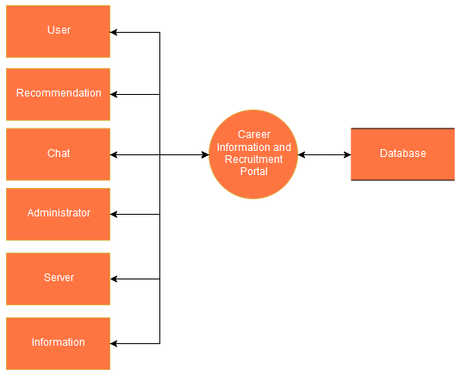
LEVEL 0
Level 0. Context Diagram for Career Information and Recruitment portal.

Slide 12
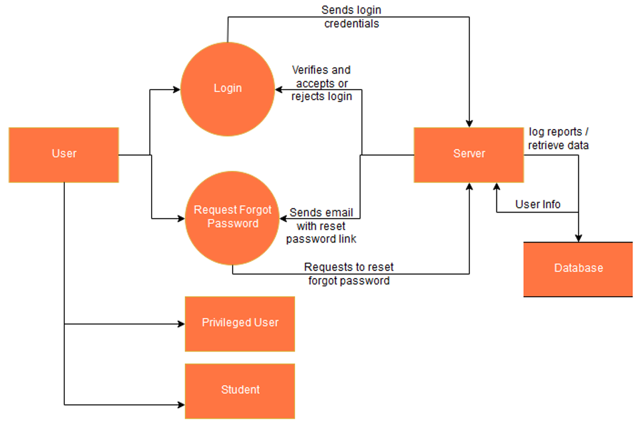
LEVEL 1 DIAGRAMS
Level 1.1 User module - implemented as class

Slide 13
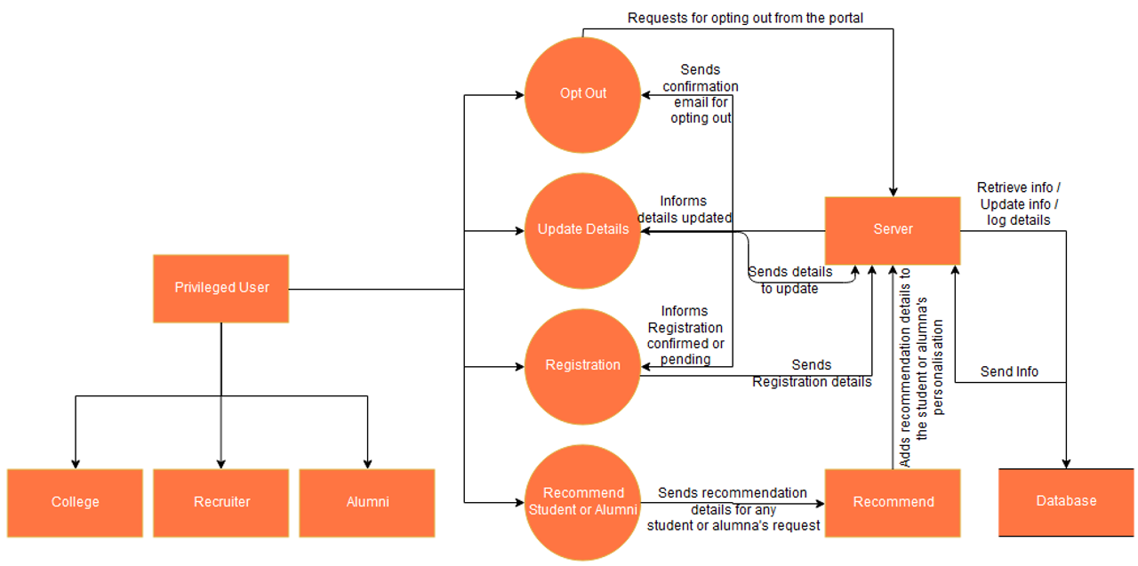
Level 1.1.1 - Privileged User (sub-module of User (1.1), implemented via interfaces only)

Slide 14
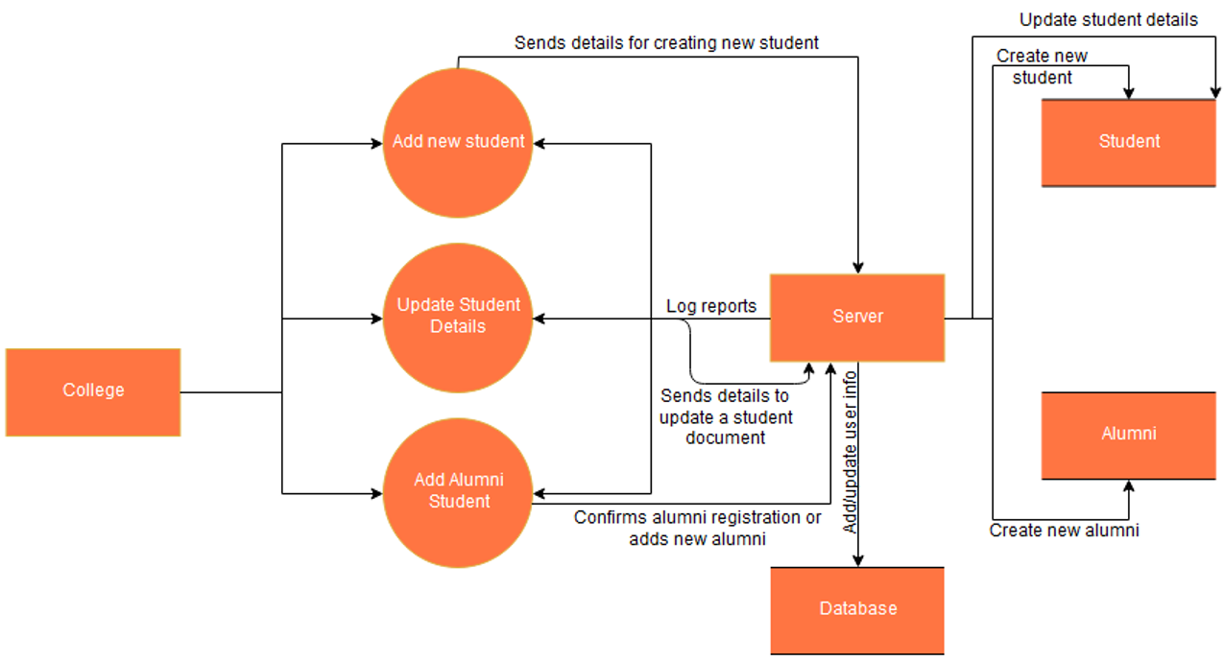
Level 1.1.1.1 - College module (implements Privileged User interface, implemented as class)

Slide 15
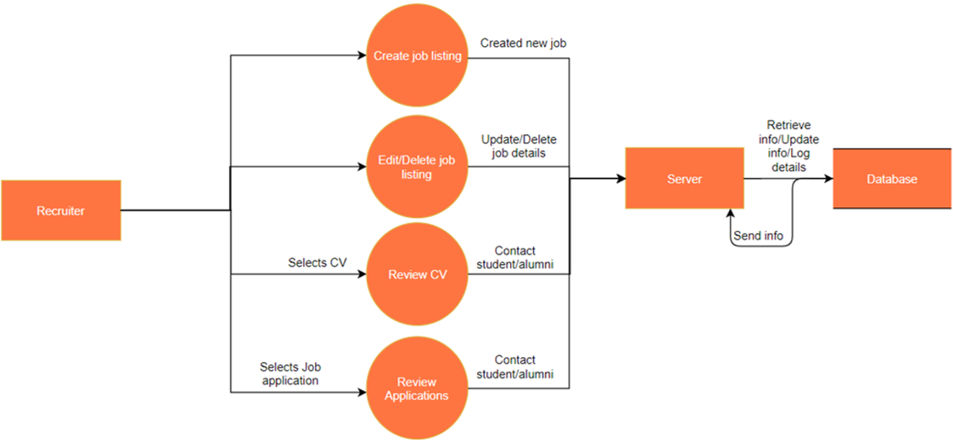
Level 1.1.1.2 - Recruiter module (implements Privileged User interface, implemented as class)

Slide 16
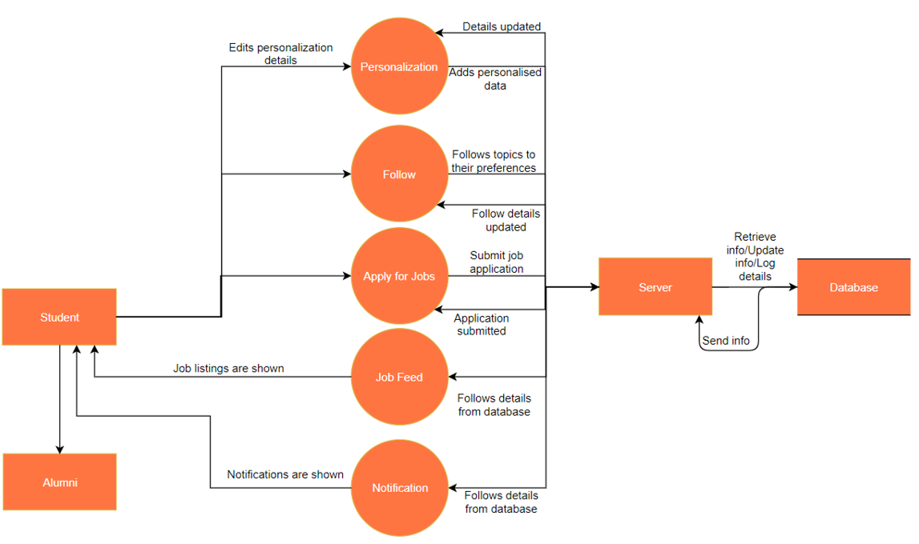
Level 1.1.2 - Student (Sub-module of User (1.1), implemented as class)

Slide 17
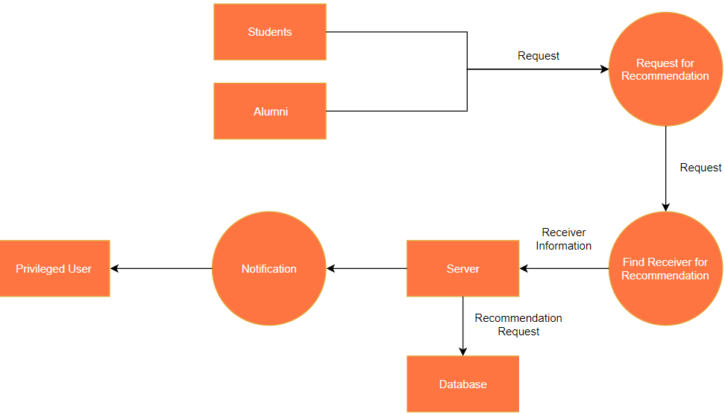
Level 1.2.1 - Request Recommendation (Recommendation module (1.2) has two functions - Request Recommendation and Recommend, both are implemented via separate interfaces and hence considered as sub-modules.)

Slide 18
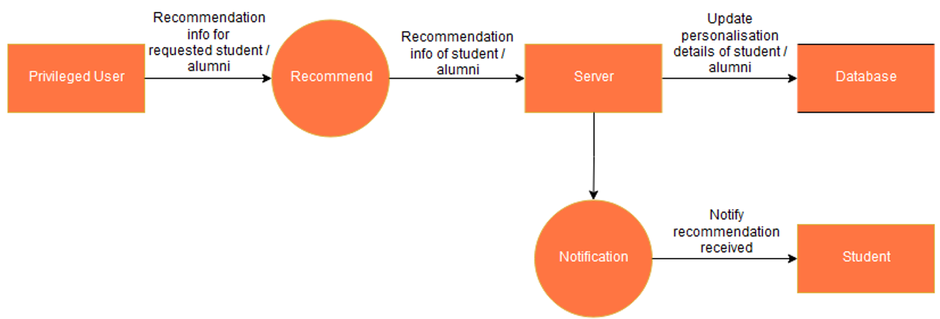
Level 1.2.2 - Recommend (Recommendation module (1.2) has two functions - Request Recommendation and Recommend, both are implemented via separate interfaces and hence considered as sub-modules.)

Slide 19
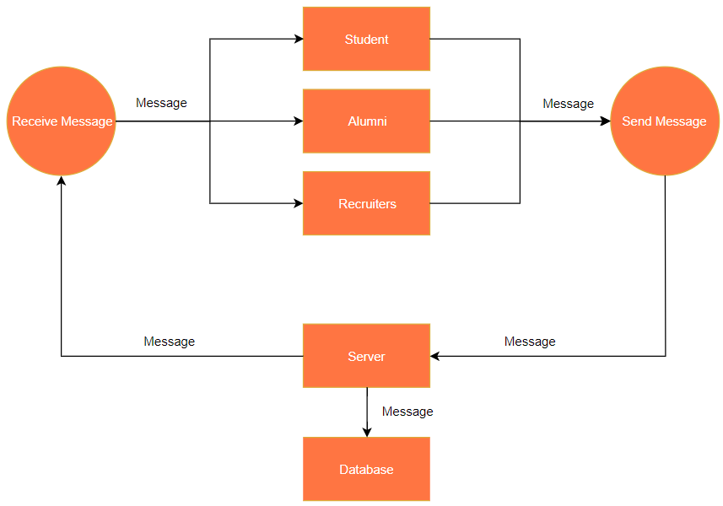
Level 1.3 - Chat (Implemented via interfaces only, implemented by Recruiter and Student classes)

Slide 20
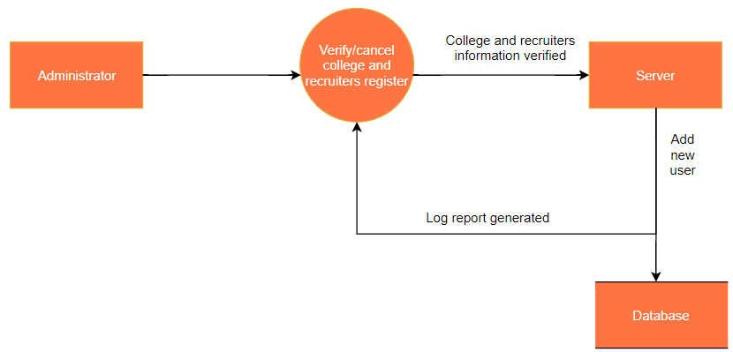
Level 1.4 - Administrator module (Implemented as class)

Slide 21
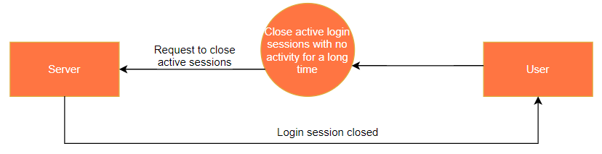
Level 1.5 - Server module (Implemented as class)

Slide 22
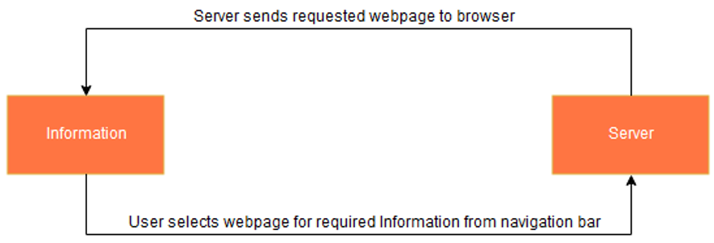
Level 1.6 - Information module (module used to display web pages for career information)

Slide 23
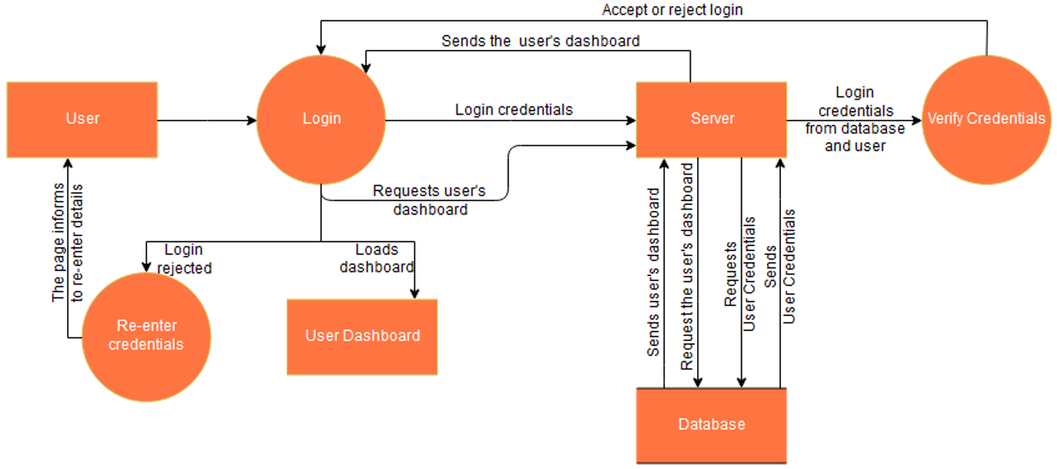
LEVEL 2 DIAGRAMS
Level 2.1 - User login

Slide 24
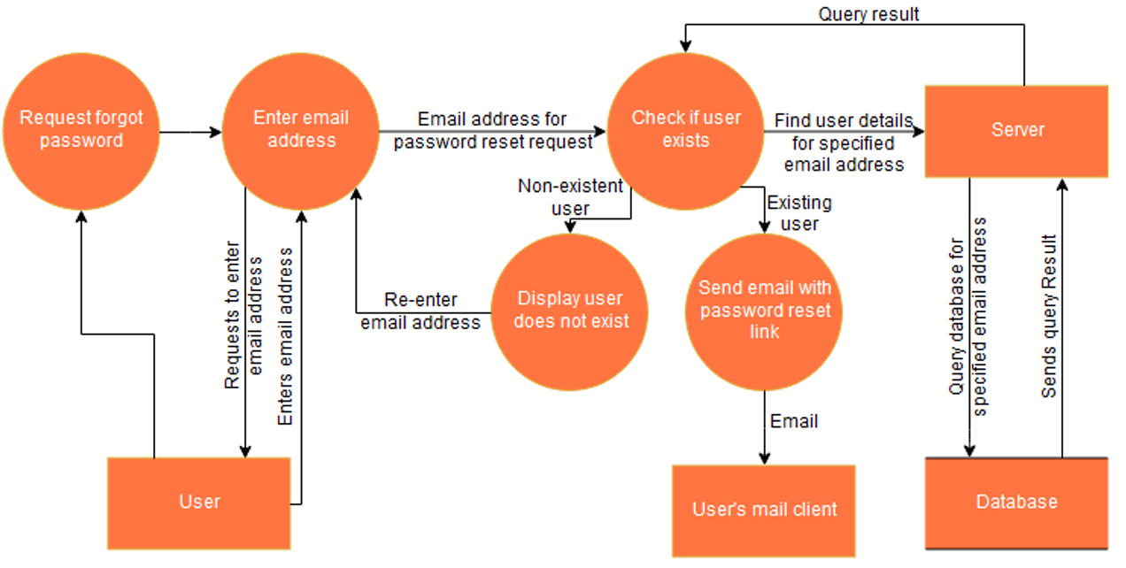
Level 2.2 - Request for forgot password

Slide 25
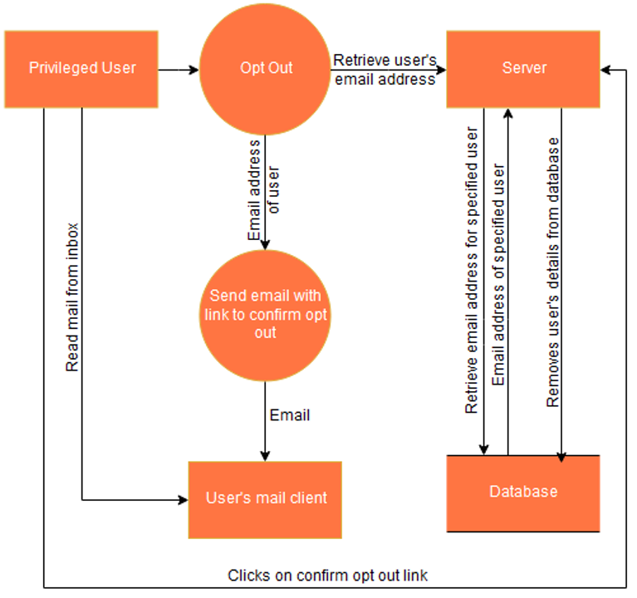
Level 2.3 - Opt out request by any privileged user

Slide 26
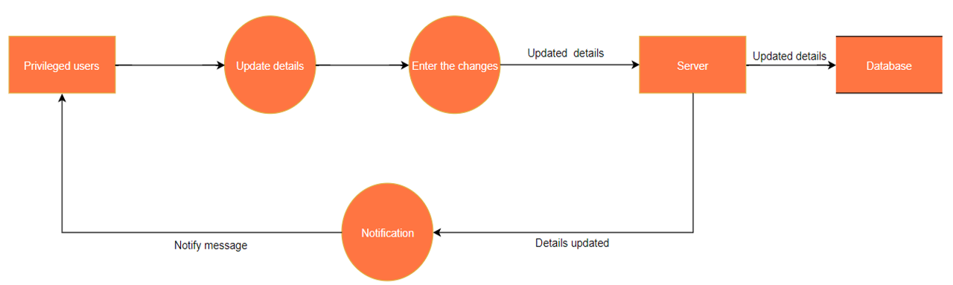
Level 2.4 - Update details of any privileged user

Slide 27
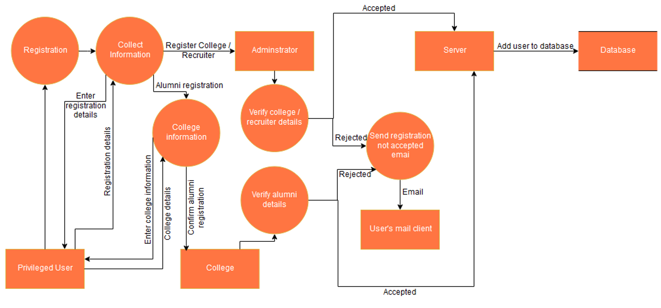
Level 2.5 - Registration of any privileged user

Slide 28
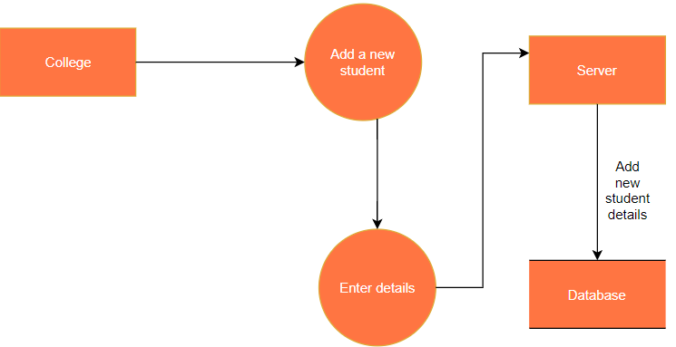
Level 2.6 - Add new student by college

Slide 29
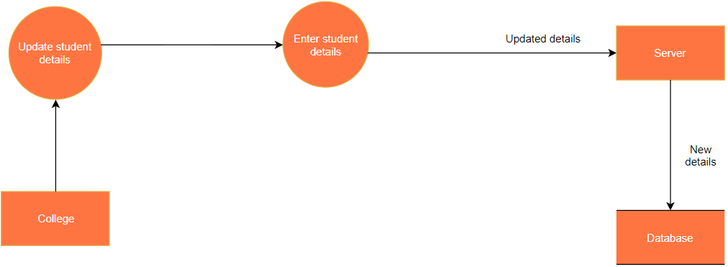
Level 2.7 - Update student details by college

Slide 30
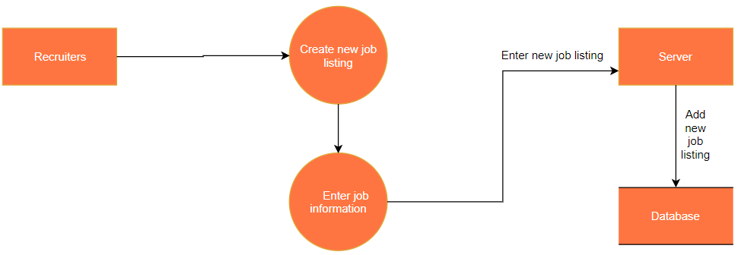
Level 2.8 - Create new job listing by Recruiter

Slide 31
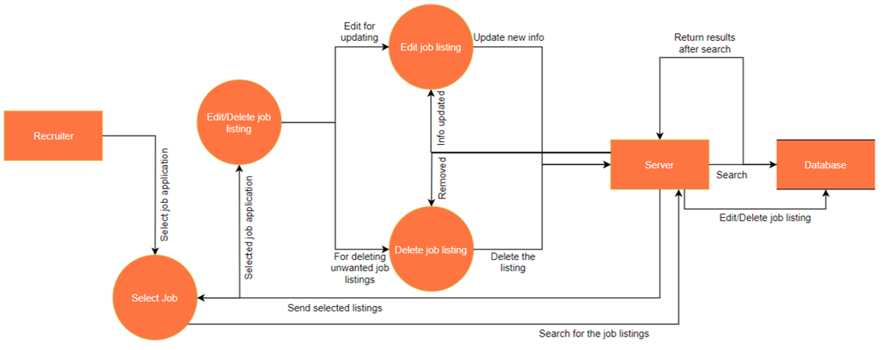
Level 2.9 - Edit or delete job listing by recruiter

Slide 32
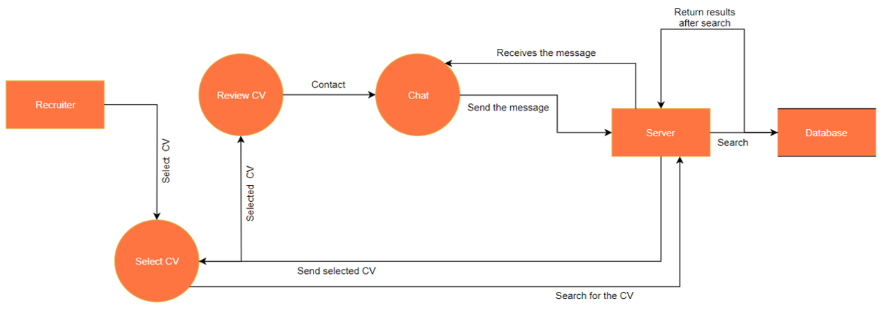
Level 2.10 - Review CV by Recruiter

Slide 33
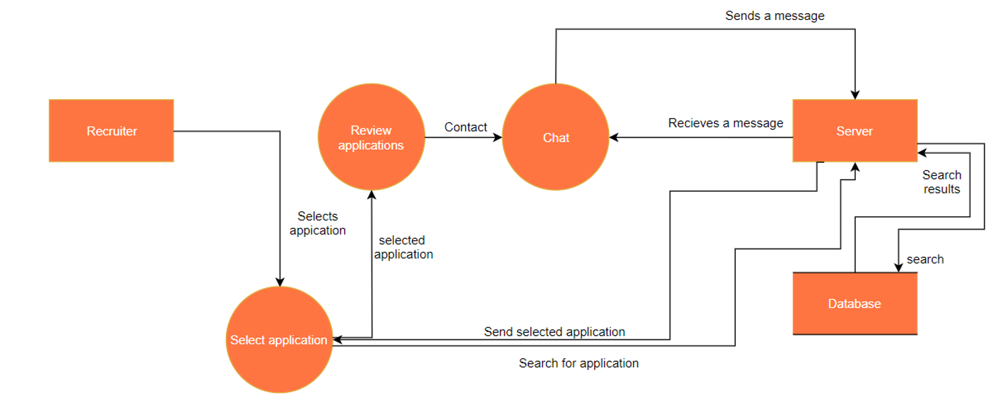
Level 2.11 - Review applications by recruiter

Slide 34
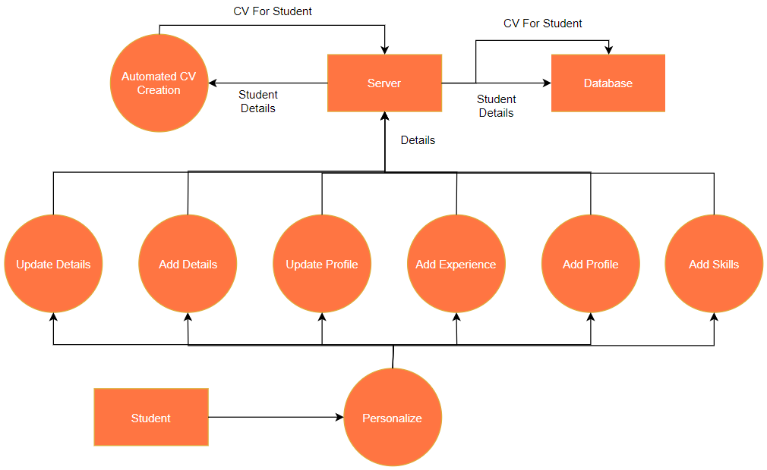
Level 2.12 - Entering personalization details by student

Slide 35
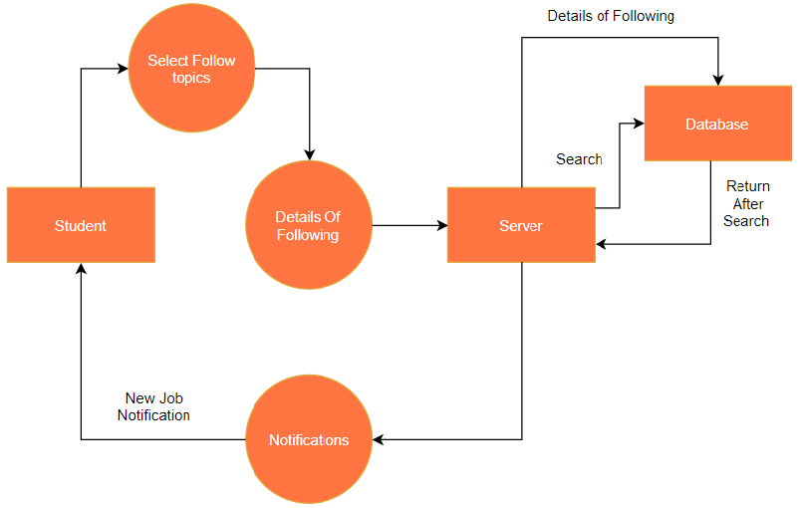
Level 2.13 - Following topics or recruiters by student

Slide 36
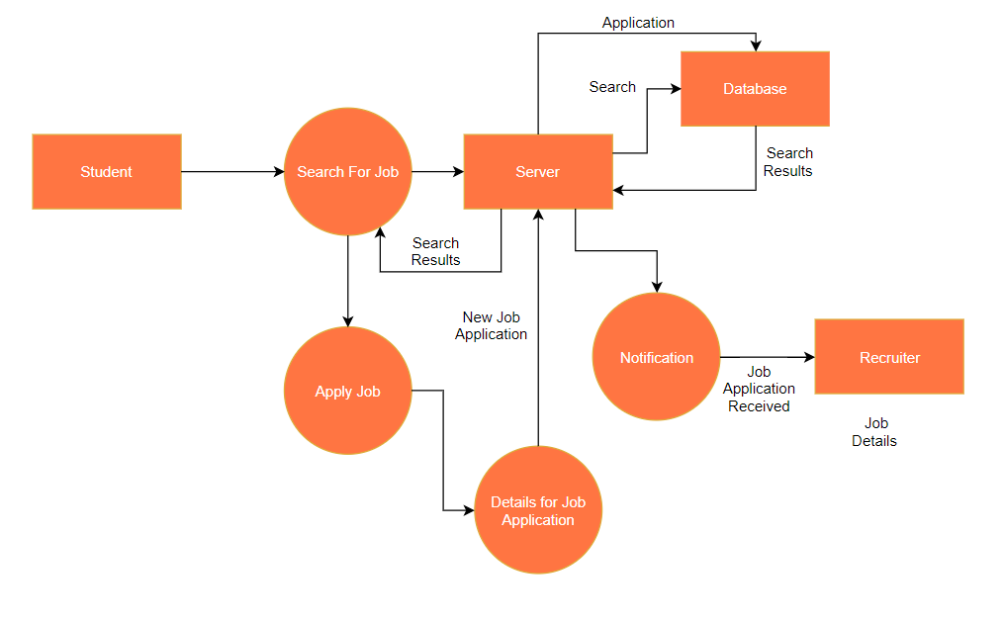
Level 2.14 - Apply for job by student

Slide 37
CONCLUSION
This project provide us a practical knowledge about java enterprise web application development using spring boot and spring security framework , and MongoDB platform.
This project offers simple and interactive forms , which helps users to access data through a simple process of registration.
We were able to develop an efficient and commercially deployable system.
Job aspirants , recruiters and colleges can take advantage of this web application as a excellent job board.

Slide 38
REFERENCES
[1] Rajib Mall, Fundamentals of Software Engineering, 2nd ed., IN: PHI, 2003
[2] Pankaj Jalote, A Concise Introduction to Software Engineering, 1st ed., UK: Springer, 2008. [E-book] Available: Springer e-book
[3] Barber L. (Mar 2006). e-Recruitment Developments. Institute for Employment Studies, Brighton. [Online] Available: https://www.employment-studies.co.uk/resource/erecruitment-developments
[4] Ranga Karanam, Creating a Web Application with Spring Boot, DZone, Jun. 02, 2017. Accessed on: Jul. 08, 2020. [Online] Available: https://dzone.com/articles/creating-a-web-application-with-spring-boot

Slide 39
THANK YOU!

